Slide 1
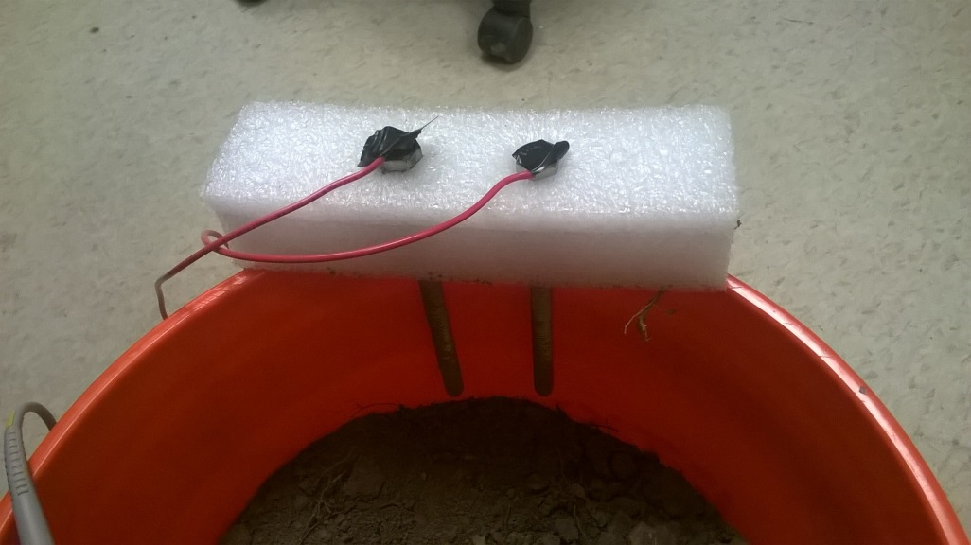
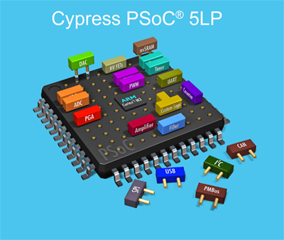

Wi-Fi Enabled Soil Moisture Sensor

Slide 2
Overview
Circuit to Measure Capacitance
Soil Moisture Sensor
Electric Imp (Wi-Fi)

Slide 3

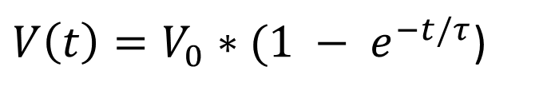

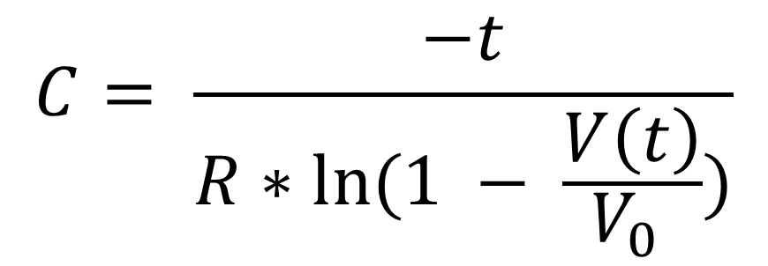

Measuring Capacitance
$$Equation For a Charging Capacitor:$$
$V\left(t\right)=V_{0}∗(1 − e^{−t/τ}$)
$$Where τ=RC$$
$$Rearranging Terms……..$$
$$C= \frac{−t}{R∗ln⁡(1 − \frac{V\left(t\right)}{V_{0} })}$$

Slide 4
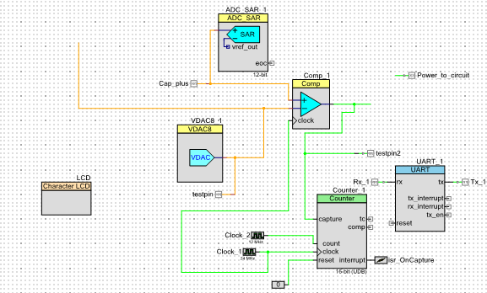
Measuring Capacitance

Slide 5
Measuring Capacitance

Slide 6
Measuring Capacitance

Slide 7
Measuring Capacitance

Slide 8
Measuring Capacitance

Slide 9
Measuring Capacitance

Slide 10
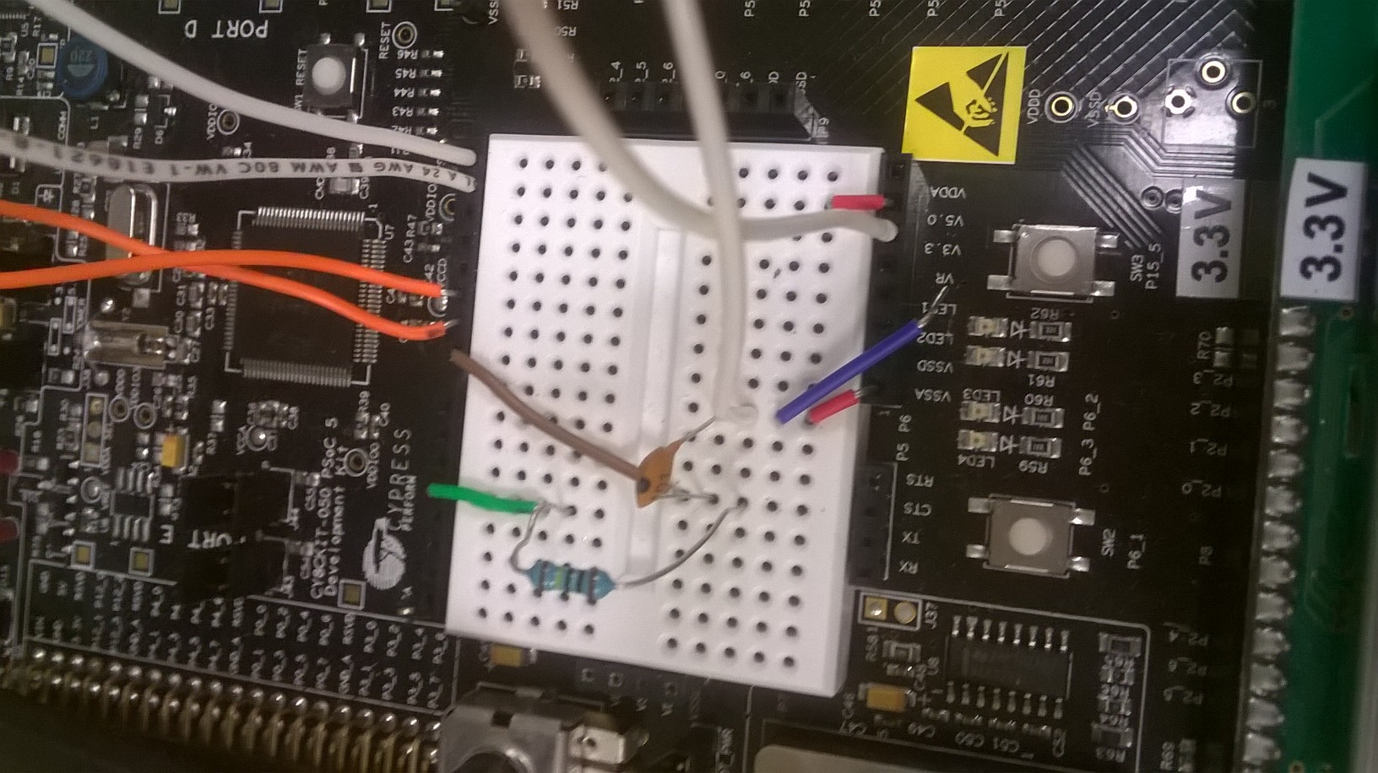
View of The Circuit

Slide 11
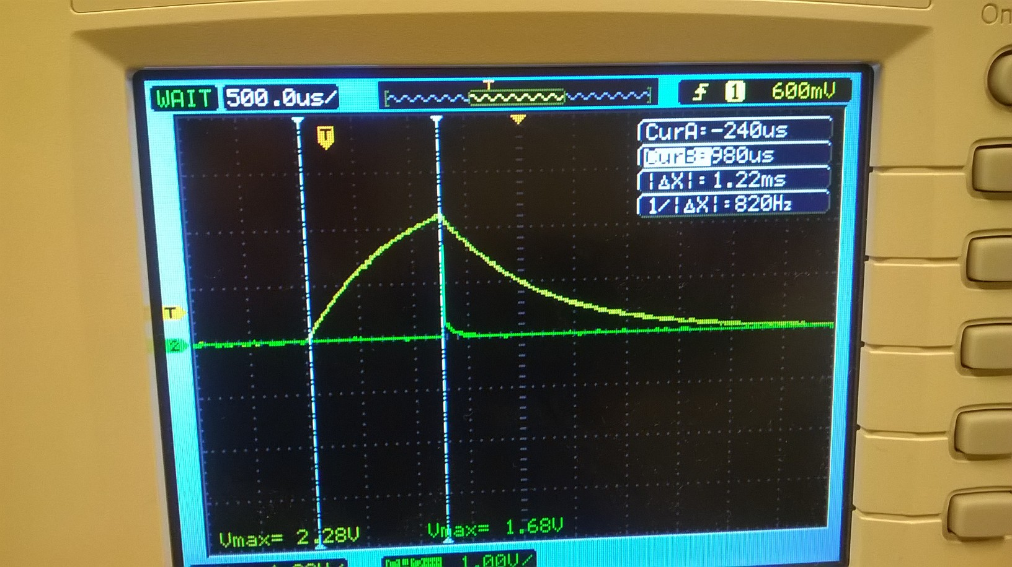
Circuit Output

Slide 12
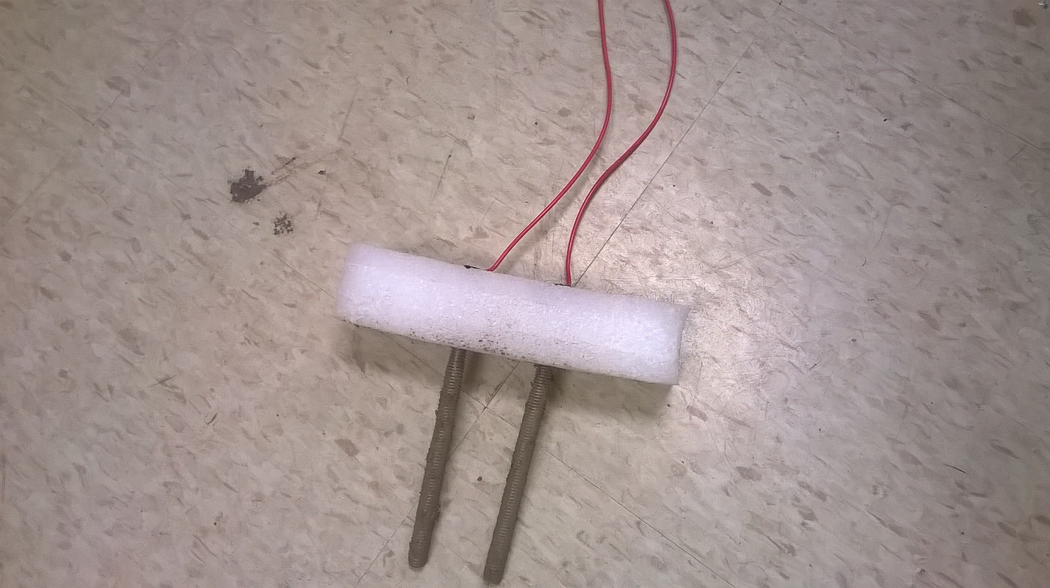
Soil Moisture Sensor

Slide 13
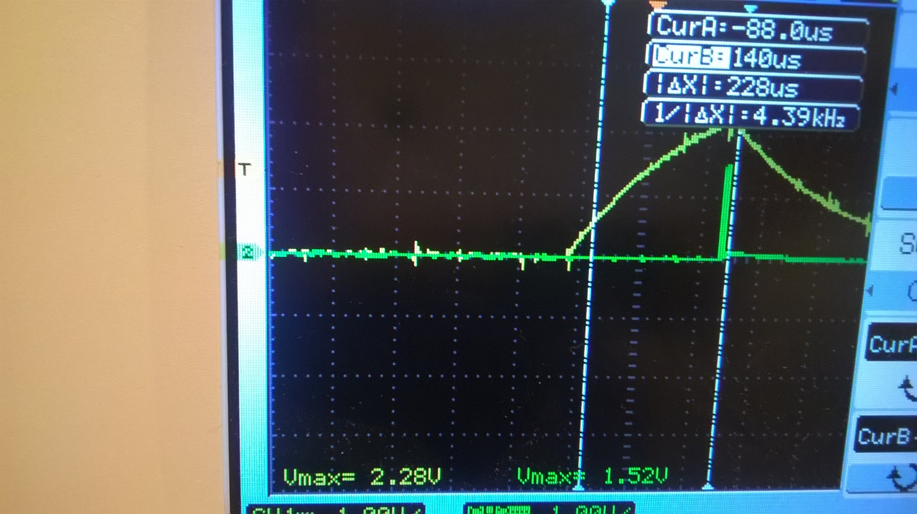
Circuit Output With Sensor In Soil

Slide 14
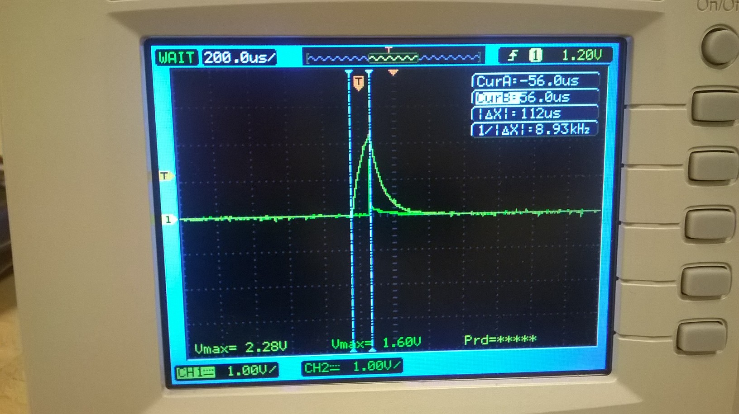
Circuit Output with Sensor in Air

Slide 15
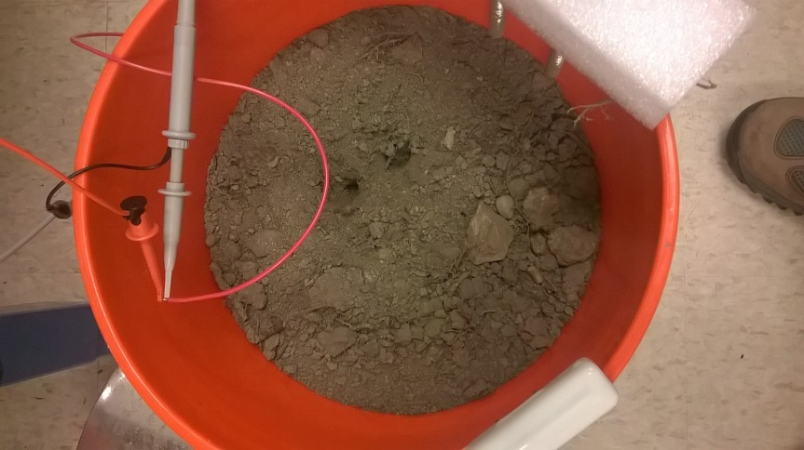
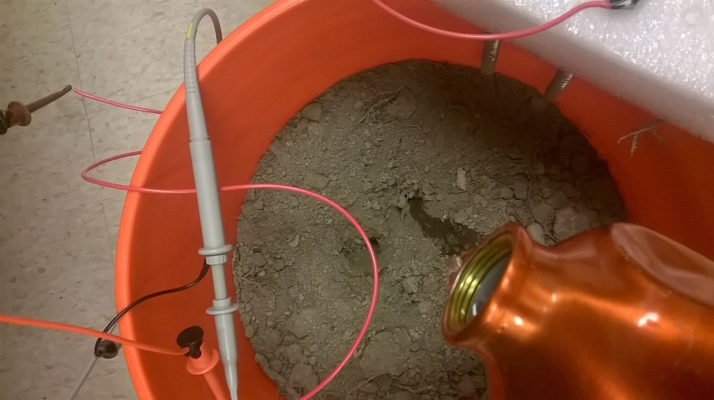

Testing

Slide 16

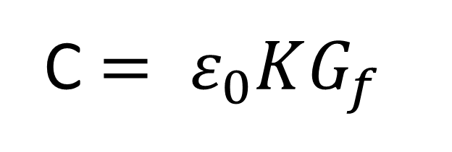
Using Capacitance to Estimate Dielectric Value of the Soil
C $= ε_{0}KG_{f}$
$$ε_{0}=Vacuum Permittivity$$

Slide 17
Testing Results

Slide 18
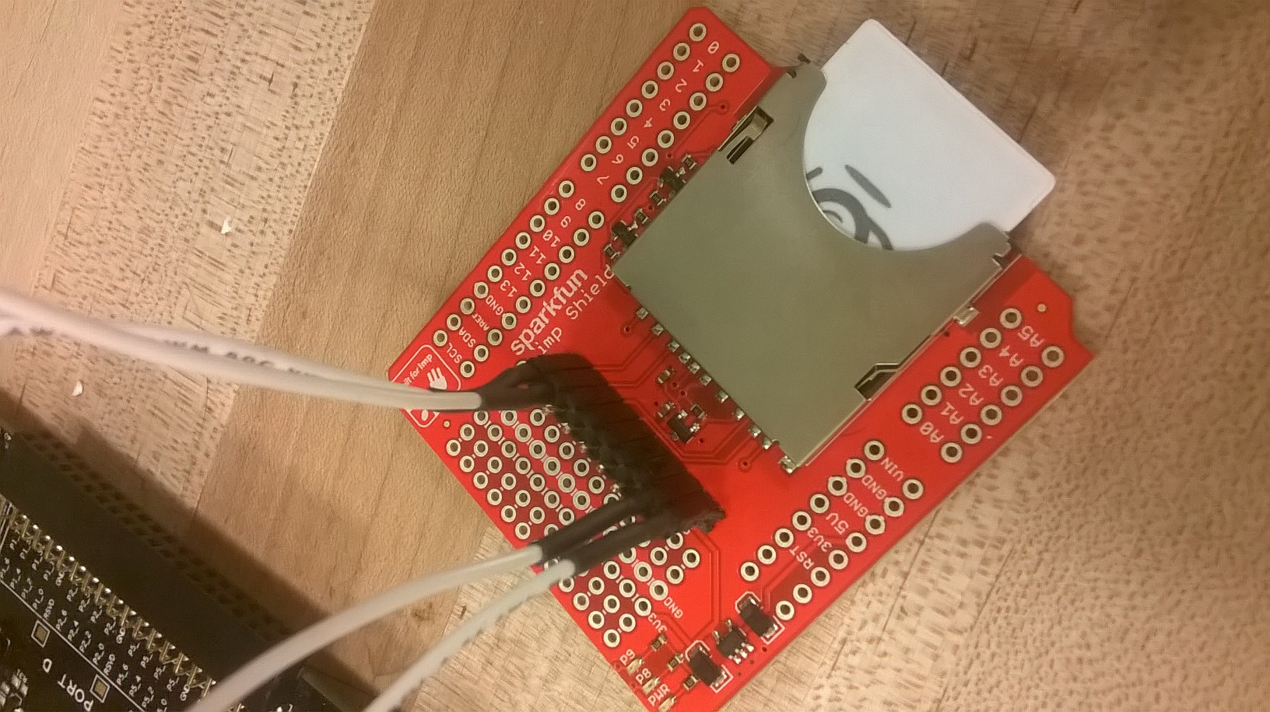
Electric Imp

Slide 19
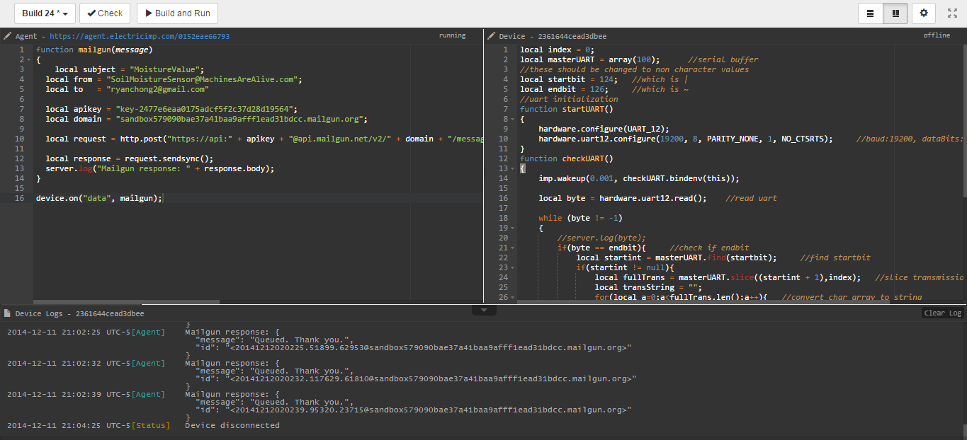
Sending Emails of Dielectric Values

Slide 20
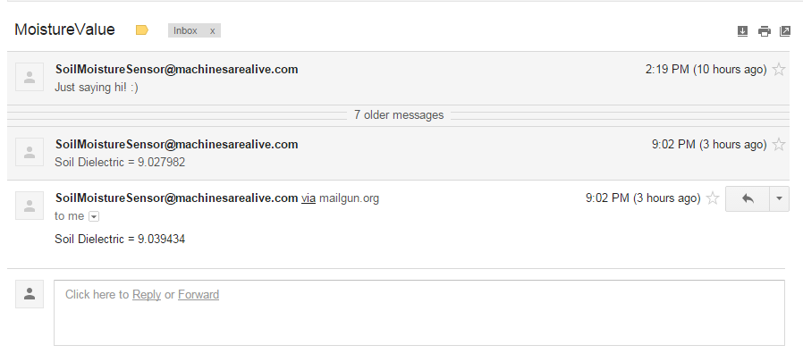
Sending Emails of Dielectric Values

Slide 21
Future Plans
Enclosure
Further Testing to Improve Capacitance Measuring Circuit
Better Calibration

